Slide 1
Intermediate presentation
Quality Assessment of Kıbrıs Gazetesi Website
CMSE 326 – Software Quality Assurance
Eastern Mediterranean University
Website: Kıbrıs Gazetesi
URL: https://kibrisgazetesi.com
Team member:
D: 21904531 | Name: Maaz Qureshi | Group: 2
ID: 22331350 | Name: Hasan Orkan | Group: 2
ID: 22002304 | Name: Samet Metehan Özyener | Group: 2
ID: 22701636 | Name: Saad Ahmad | Group: 1

Slide 2
Overview
Introduction
Team Roles & Work Distribution
Brief Information About the Website
Testing Strategy
Tests Performed (Intermediate Phase)
Key Results & Recommendations

Slide 3
Introduction
In this project, we are analyzing the quality of the Kıbrıs Gazetesi website — one of the top news platforms in Northern Cyprus.
Our main focus is to check how well the site performs in terms of usability, accessibility, functionality, and overall user experience.
By following a structured testing process, we aim to discover any issues or areas that could be improved.
The goal is to make sure the website is not only reliable but also easy to use and accessible for all types of users.

Slide 4
Team Roles & Work Distribution
Team Members | Roles | Key Tasks
Maaz Qureshi | Project Manager/ Support Tester | Organize meetings, track progress, compile reports, and assist in testing
Hasan Orkan | Main Tester | Conduct main quality assurance tests
Saad Ahmed | Support Tester | Assist in testing and report issues
Samet Metehan Özyener | Report Writer/ Support Tester | Format reports and assist in testing

Slide 5
Brief Information About Website
Kıbrıs Gazetesi is a well-known newspaper in Northern Cyprus, active since 1989, now available online.
The website covers:
TRNC, Turkey, Global, and Greek news
Articles, sports, economy, interviews, videos, and more
Users can also access:
Live TV and radio
Main Sections:
TRNC, Greek Press, World, Economy, Sports, Interviews
Authors (Columns), Obituaries (Deaths), All News
Homepage Highlights:
Top news, author articles, YouTube videos, exchange rates, sports scores
User Features:
Search bar for finding content
Commenting and sharing options
Adjustable text size, reading modes (light/dark)
Responsive design (works on different screen sizes)

Slide 6
Overview of the Testing Strategy
Black-Box Testing:
No access to source code; focuses on externally observable behavior.
Combination Approach:
Automation Testing: Utilizes web-based tools for performance, accessibility, and more.
Manual Testing: Ensures real-world user interactions and nuanced assessments.

Slide 7
Testing Procedure
1: Selection of Testing Tools:
Identify and select the most appropriate tools (e.g., GTmetrix, WAVE, LambdaTest) for each test type.
2: Execution of Tests:
Perform both automation and manual testing to comprehensively evaluate functionality, usability, performance, security, and compatibility.
3: Result Evaluation:
Analyze data collected from each tool against industry benchmarks to identify strengths and weaknesses.
4: Recommendations for Improvement:
Develop actionable recommendations based on test outcomes to enhance overall website quality.

Slide 8

Tests Performed So Far
1.Performance Testing
2. Accessibility Testing
3.Cross-Browser Testing
4.Mobile Responsiveness Testing

Slide 9
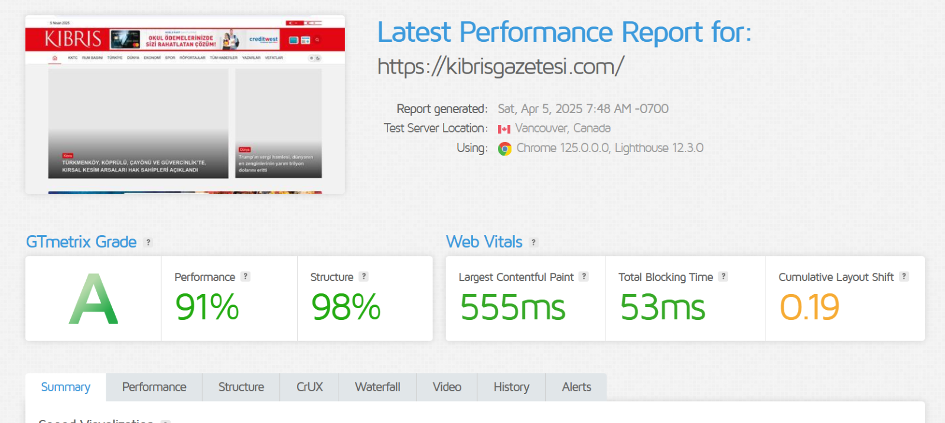
1.Performance Testing
The testing was evaluated using GTmetrix
Performance Grade (A):
Performance Score (91%): This is a solid score, showing that the website is very fast and optimized.
Structure Score (98%): Almost perfect!
Page Size (1.46 MB)The page size is well-optimized for quick loading.
38 Requests: The number of requests is relatively low, contributing to a fast loading time.
Total Load Time (0.8 seconds): Very fast! This is excellent for user engagement.

Slide 10
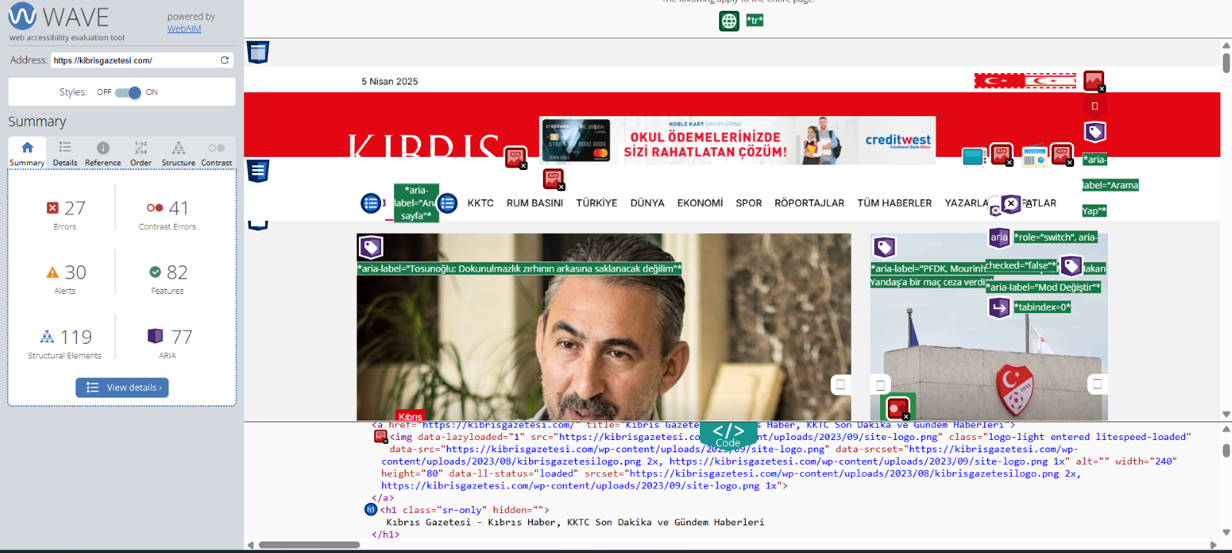
2. Accessibility Testing
The testing was evaluated using WAVE
Reported 27 accessibility errors, 41 constrast errors and 30 alerts
82 accessibility feature, along with 119 structural elements and 77 ARIA labels positive
Include missing alternative text for images, unlabeled buttons or form elements
poor color contrast ratios
challenging for people relying on screen readers

Slide 11
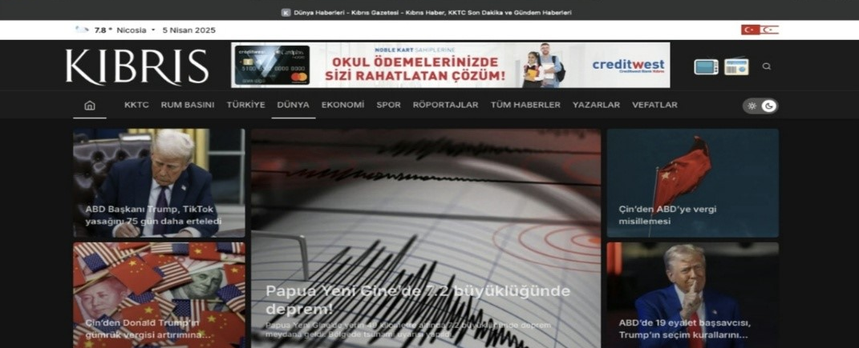
3.Cross-Browser Testing
The testing was evaluated using Lamda Test
Tested on:
Windows 11 (Google Chrome)
MacOs Sequoia (Safari)
Linx
The results demonstrated layout and features worked the same on all the tested browsers.

Slide 12
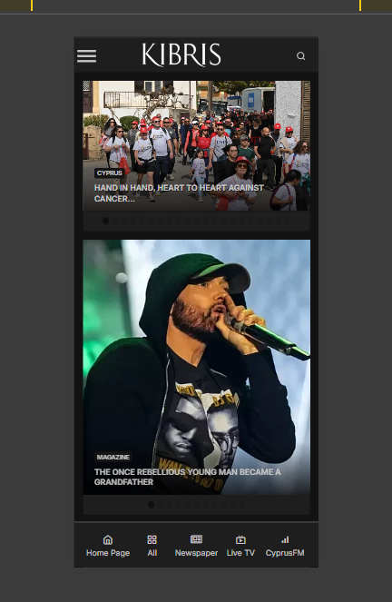
4.Mobile Responsiveness Testing
The testing was evaluated using multiple devices such as:
IPhone 14pro
IPad Air
Samsung Galaxy s20
Chrome
And desktop screens
Website content resized properly; navigation and UI components performed well across devices.

Slide 13

Recommendations
Performance Testing: Speed up the website by setting exact sizes for pictures and ads, and combine files to reduce loading steps.
Accessibility Testing: Fix missing labels and text for images, and make sure colors are easy to read so everyone can use it easily.
Cross-Browser Testing: Check older browsers like Safari 14 and adjust design code to make the site look good everywhere.
Mobile Responsiveness: Test new phones and tablets, and make buttons bigger and easier to tap to keep mobile experience smooth.

